Slide 1

POJRECT 2: CHATBOT
Group Members:
Ravi Dawar
Ramesh Subedi
Submitted TO:
Prof. Kamran Z. Khan
BUAN 6v99.001 – Special Topic -Natural Language Processing

Slide 2
Objective: Build a Chatbot with services which can identify the intent of user based on user interaction and trigger the function associated with it to get the desired output using API’s.
Approach: Our Approach is simplistic that is making use of short user defined conversations between user and chatbot to get the desired result, Making the model with minimum user inputs which can trigger defined function associated with the API’s
Set-Up: Google Cloud platform account (For obtaining GOOGLE_APPLICATION_CREDENTIALS used to access google API’s: Google $200 credit for new account setup),
Google ApI’s : Speech to Text API (Speech Recognition), DialogFlow API (For intents and entity type ), Text Translate API, Places API, Directions API, Geocoding API, Geolocation API
Yahoo Weather API, News API

Slide 3
Required Deliverables :
Part 1: Speech to text using Google api
- Google returns the text without intent (DONE)
Part 2:
Option 1: call Google dialogflow to pass text from part 1
-output: entities (DONE: Using Google Dialog Flow API for intent and Entity analysis )
Part 3: Use the entities from part 2 to take action: such as
-direction to a restaurant
-Weather Forecast
-Jokes
-News Headlines
-Text Translation

Slide 4
Scenarios Covered:
-Direction to a restaurant
-Weather Forecast
-Jokes
-News Headlines
-Text Translation

Slide 5
Dialog Flow Agents:
Dialogflow agents use machine learning algorithms to understand natural language utterances, match them to intents, and extract structured data. An agent learns both from training phrases that you provide and the language models built into Dialogflow.
Agent Creation and training:
We used training phrases to create individual intents and tagged the required entities which can be associated with intents respectively
Example :
Training phrases for intent : Jokes.get
“ Tell me a joke”
“Can you tell a joke”
Training phrases for Intent: Weather
“How is the weather today”
We trained other intent similarly

Slide 6
Flow of Instructions :
Scenario 1: Weather Report
- Ask user for city
- Call yahoo weather API
- Display the results obtained from API
Scenario 2: Jokes
- Display the results from file Jokes.txt
Scenario 3: News Report
- Call the news api
- Display the results

Slide 7
Scenario 4: Text Translation
- Default Input language is English
(Can also be changed to other Language Like: Hindi, Spanish)
- Users Selects the Target Language
(We have limited Target language selection to Hindi, Chinese, French and German)
- Ask User for text which is to be translated
- Call the Google translate API for Text Translation
- Display Result

Slide 8
Scenario 5: Direction to a Restaurants
- Ask User for cuisine preference
- Ask User for Location preference
(Like nearby places or any specific location like “Plano”)
- Provide user with List of restaurants based on user inputs
- User selects the restaurants from the List
- Direction to the Selected Restaurant is displayed

Slide 9
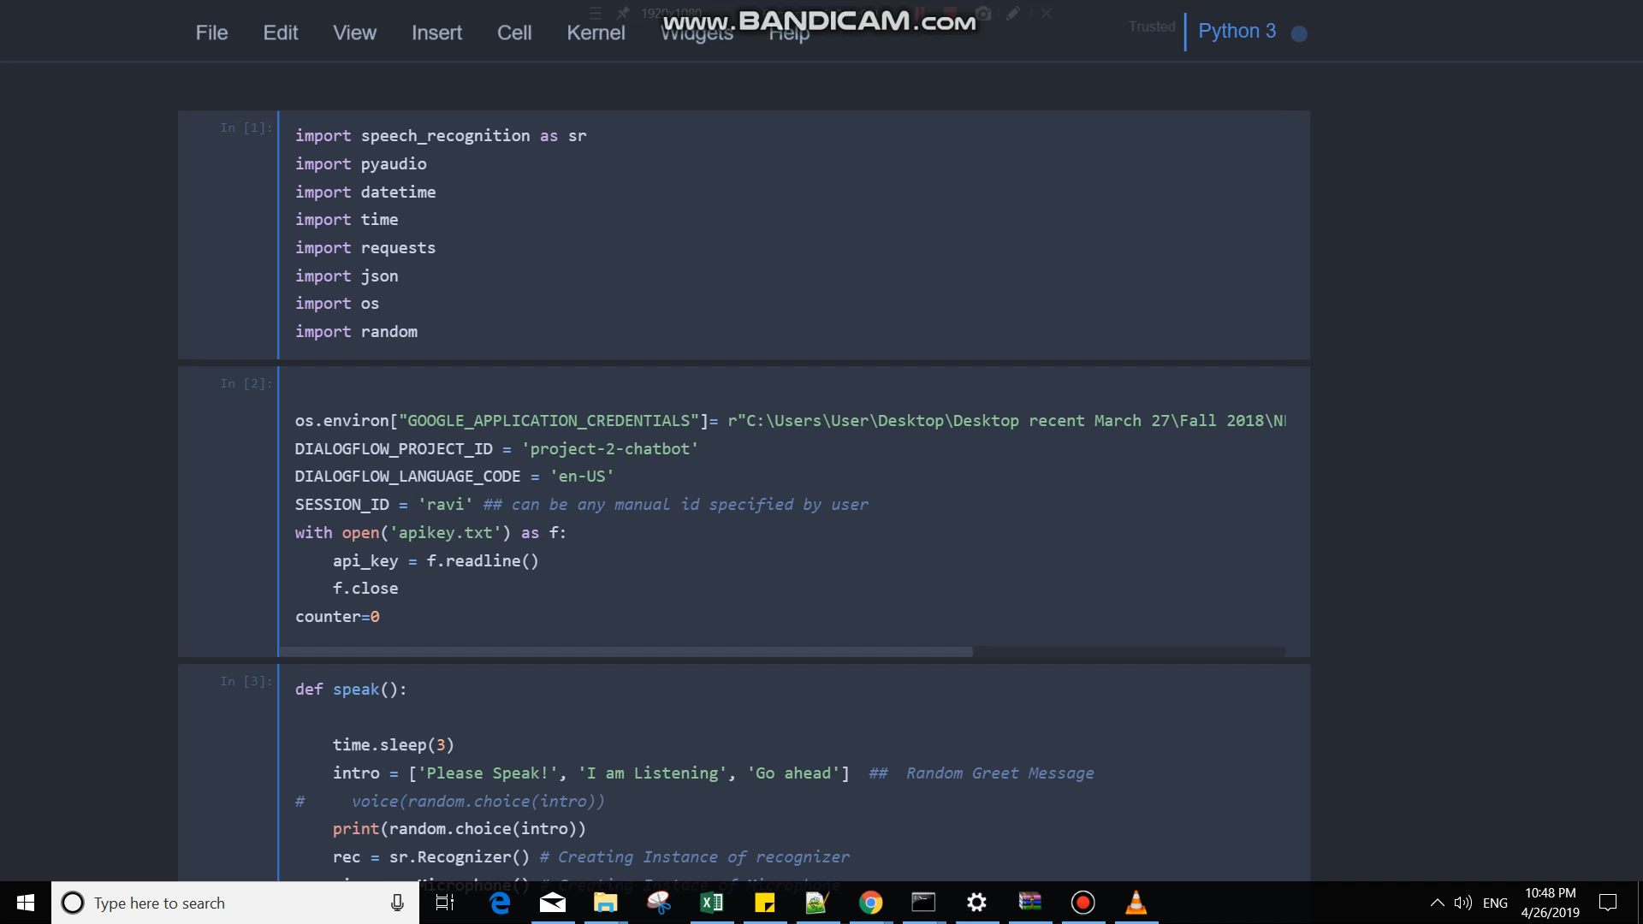
Code Output:

Slide 10
Thank you

